Slide 1
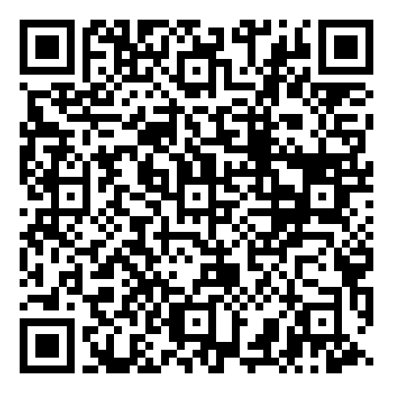
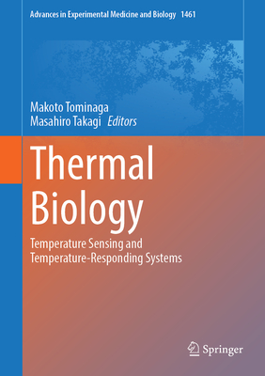
New Science Book Information from UNIV. CO-OP
Thermal Biology
(Advances in Experimental
Medicine and Biology, Vol.1461)
※大学生協洋書オンラインストアの該当商品のページへ
2024年9月
刊行予定
This book concerns two subthemes, 'temperature sensing' and 'temperature-responding systems', addressing the questions of how temperature is sensed and how temperature is related to biological functions, respectively. Temperature affects various physiological functions and is one of the most important factors in homeostasis. The book seeks to integrate our understanding of temperature-dependent biological phenomena with the development of techniques that detect and regulate local temperatures in cells and organs with high resolution and precision.
Part I: “Temperature sensing” addresses temperature sensing mechanisms by focusing on plasma membrane molecules, intracellular molecules and intracellular metabolic pathways. This part seeks to develop ways to detect and regulate local temperatures at a cellular level, which would facilitate future temperature- sensing research.
Part II: “Temperature- responding systems” focuses on the neural circuits that integrate information concerning ambient temperature sensation, the effects of temperature on metabolic functions and biological rhythms, and mechanisms involved in emotion formation. This part clarifies crosstalk between temperature-responding systems by developing methods to detect and regulate local temperatures in organs.
Authors of this book are leading researchers investigating temperature-sensing mechanisms across a wide range of biological responses from molecular to whole organism levels. The book promotes an integrated understanding of temperature-dependent biological phenomena under a novel discipline, 'thermal biology', which leads to a novel concept wherein 'temperature' as a physical quantity could be viewed as an element of new signaling mechanisms.
●著者：Tominaga, Makoto / Takagi, Masahiro 編集
●出版社：Springer-Verlag GmbH
●ISBN：978-981-97-4583-8
●刊行：2024/09
●hardcover/800p.
●動物学
編集の冨永先生よりコメント：
「温度はすべての生命現象に関わります。最初の温度受容体TRPV1の発見によって2021年のノーベル賞を受賞したのDavid Julius先生が序文を書いてくださいました。温度生物学の世界をのぞいてみませんか？」
組合員価格は生協店舗にお尋ねください
＊海外からの仕入れのため為替レートの変動により価格は変動します。
研究費・科研費でのご購入は生協が便利で安心！
注文書
Thermal Biology ご注文 冊
氏名: TEL: お支払方法（○で囲む） 校費・私費
学部名； 学科名： 研究科or研究室名：
大学生協洋書オンラインストア:https://yosho.univcoop.jp/BookShop/
書籍ポータルサイト: https://online.univ.coop/book_front/
発行：2024年7月24日

